Slide 1

基于Microsoft Teams 构建应用集成和工作流 陈 希章 | 微软（亚洲）互联网工程院
实施 Microsoft 身份（一）
实施 Microsoft 身份（二）
Microsoft Graph 简介
扩展 Microsoft SharePoint
扩展 Microsoft Teams (一）
扩展 Microsoft Teams (二）

Slide 2
扩展和定制 SharePoint
开始使用 SharePoint 框架
使用 SharePoint 框架开发 Web 部件
利用 Microsoft Graph 和第三方 API
使用 SharePoint 框架构建 Microsoft Teams 自定义项

Slide 3
开始使用 SharePoint 框架
SharePoint 框架简介
配置你的 Office 365 环境
配置你的开发环境
Notes:
This section will introduce you to the SharePoint Framework and walk you through getting your local & online environment configured for developing with the SharePoint Framework.

Slide 4
SharePoint 框架简介

Slide 5


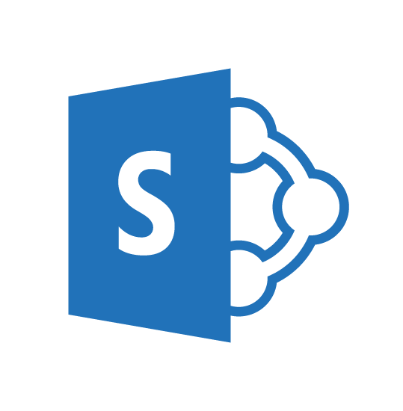
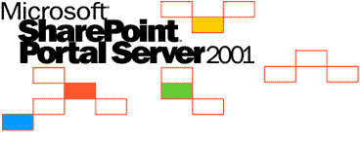
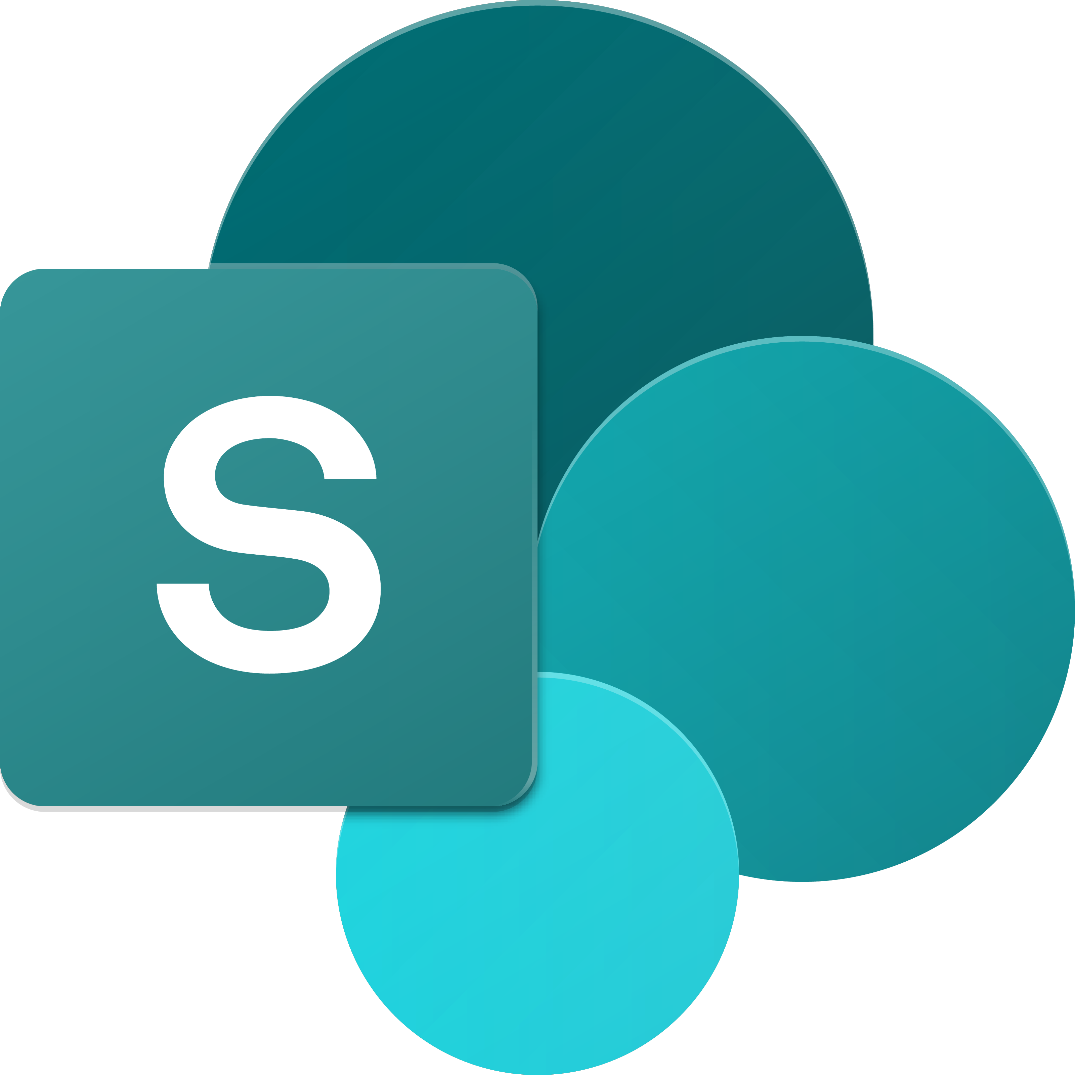
SharePoint UX – 经历多个版本的发展
SharePoint
Portal Server 2001
SharePoint
Portal Server 2003
Office SharePoint
Server 2007
SharePoint
Server 2010
SharePoint
Server 2013
SharePoint
Server 2016，SPO
2001
2003
2006
2009
2012
2016 …
ASP
早期服务器小组件技术
单箱
ASP.NET
Web 部件
CAML
SharePoint 发布
快速收购
共享服务（如分类学）
首次使用 XSL 进行客户端渲染
搜索驱动的出版网站添加了客户端渲染，如 CBS、MDS 等。
混合环境
现代独立云应用，例如 Office 365 视频、Delve 等。
…
SPFx 和 Office Fabric
现代 SharePoint 页面
Notes:
The SharePoint user experience has been evolving across multiple versions throughout the years.
SharePoint has a long history going back to the first release of SharePoint Portal Server 2001. The figure above displays the versions of SharePoint Microsoft has released over the years. After the initial release, Microsoft rewrote SharePoint on ASP.NET and introduced web parts in with the SharePoint Portal Server 2003 release.
As SharePoint's popularity grew, developers started to take interest in extending the product. Office SharePoint Server 2007 introduced multiple capabilities for developers, namely features, and solutions. Microsoft also merged the Microsoft Content Management Server, web content management solution, into SharePoint as site publishing capabilities.
SharePoint Server 2010 added multiple shared services to the product, including taxonomy, shared search services, and the ability to incorporate external business data into SharePoint sites.
In 2012, Microsoft introduced a new development model enabling developers to externalize customizations to run either in the browser, or on servers other than the servers were SharePoint was installed. This new model, the SharePoint Add-in model, was introduced in SharePoint Server 2013 and was released along with significant investments to the SharePoint REST API. SharePoint Server 2013 also adopted the OAuth 2.0 protocol and introduced the ability for developers to create apps that had their own identities.
More recently, with SharePoint Server 2016, SharePoint Server 2019, and SharePoint Online, Microsoft noticed customers were using client-side development techniques to customize and extend SharePoint. Client-side customizations are the foundation and inspiration for the SharePoint Framework.
Present day SharePoint exists in one of two versions:
- **SharePoint Server 2019**: This is the on-premises version of SharePoint that customers install and maintain on their servers.
- **SharePoint Online**: This is the hosted version of SharePoint, managed by Microsoft as part of Microsoft 365.

Slide 6

SharePoint 框架可扩展性原则 构建长期增值的企业移动性服务
原则
提供一个应用开发框架，使第一方和第三方保持一致。
在本地和云端构建行业领先的客户端解决方案
在桌面或任何设备上释放 SharePoint 和 Microsoft Graph 的潜力
Notes:
Over the past several years, with the evolution of Office 365, development of SharePoint solutions has a new set of challenges: while on one hand IT and Tenant administrators require a new set of tools to control how data get accessed and consumed in their tenancies, developers want to programmatically control the whole lifecycle, experience, and data access capabilities of a Site.
Unfortunately, developers today find themselves constraint around building app parts because of iFrames, a reduced set of APIs, and no integration with cross Office 365 workloads. This in turn limits their ability to develop powerful portals that extend SharePoint.
The client-side development framework will deliver capabilities that will help both first party and third-party developers build powerful, rich applications and provide an enjoyable web experience in Office 365 for end users that are both intuitive and simple to consume.

Slide 7
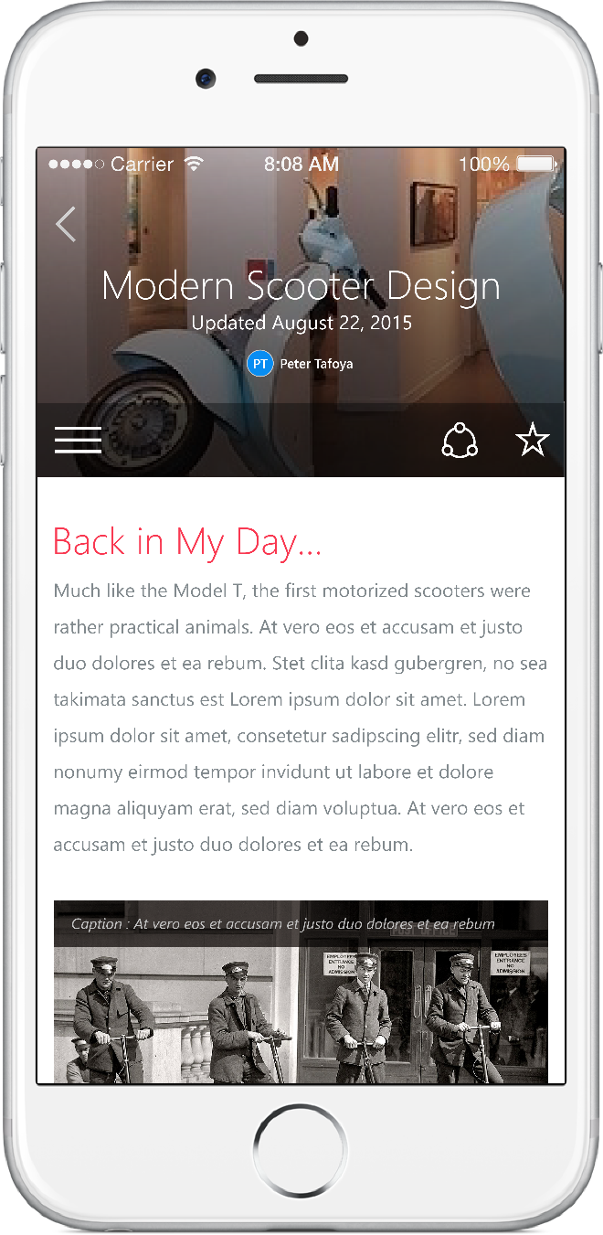
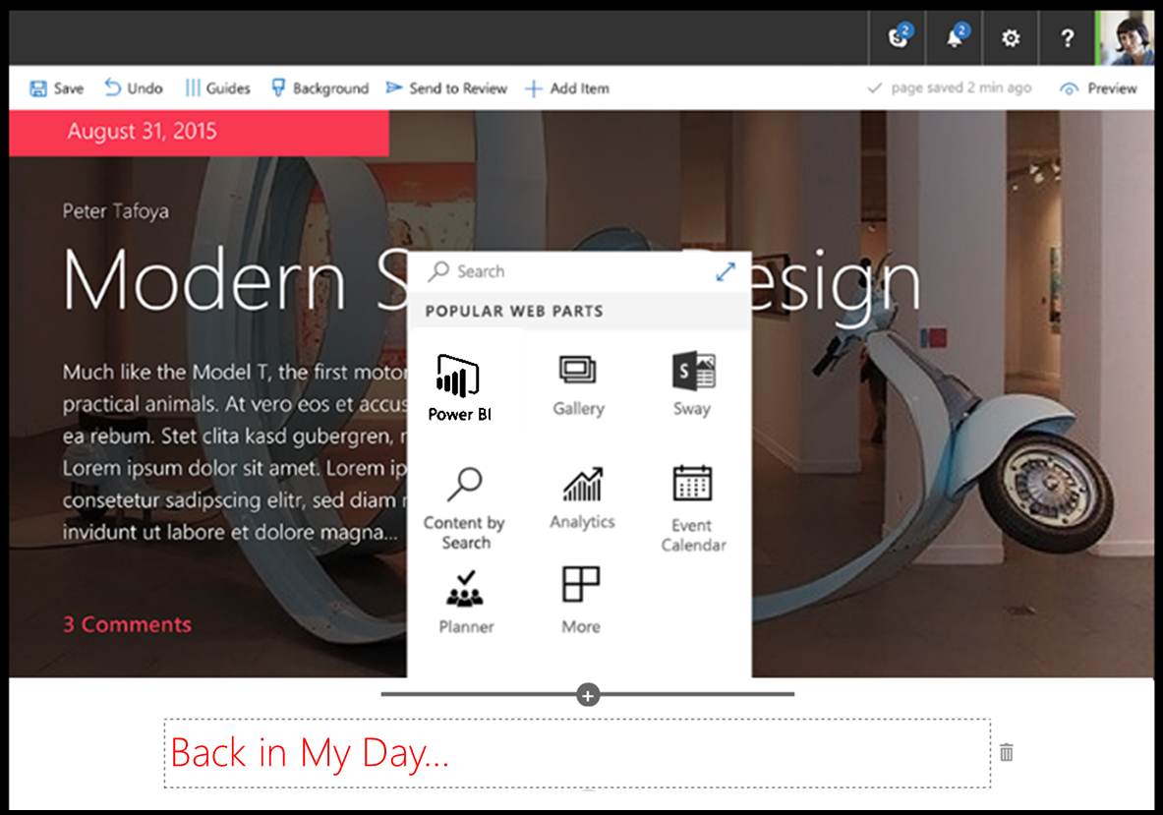
SharePoint 框架
现代客户端开发
轻量级的 Web 和移动设备
支持我们自己的体验
向后兼容
支持开源工具和 JavaScript Web 框架
SharePoint 框架
Microsoft Graph
LOB 系统和云服务
Notes:
SharePoint Framework is modern client-side development. All the customizations you create and build are deployed and run in the browser. There is no server-side component in a SharePoint Framework component.
You can create server-side components, but you're going to host that yourself in a location other than SharePoint.
SharePoint Framework components are lightweight and run in both web and mobile experiences because they are client-side solutions. We're relying on JavaScript, HTML, CSS, and images. This means they run the exact same way in the browser as it does in the mobile experiences.
The SharePoint Framework is backwards compatible meaning that it works not just the modern pages, but also on classic and publishing pages as well.
The development tools and platform used in the SharePoint Framework is implemented with open-source tools and common JavaScript web frameworks like React.

Slide 8

什么是现代页面？
客户端渲染
本机响应
客户端侧 Web 部件
客户端缓存和保存的缓存
移动优化
Notes:
What is a modern page?
The difference between a modern page and classic pages is that a modern page is rendered client-side. Modern pages aren't rendered server side, which is how SharePoint developers use to build component such as server-side based web parts.
Modern pages are natively responsive meaning that when the browser is resized, it's going to resize and re-render the page appropriate for the current resolution and experience.
Web parts you create will run and be rendered client-side; Client-side components can also use persistent caches so data that's cached by the SharePoint Framework API can be used by custom components on modern pages.

Slide 9
配置你的 Office 365 环境

Slide 10
Office 365 开发人员租户设置步骤
注册 Office 365 开发人员租户
创建应用目录网站
创建用于测试的新网站集 – dev 或 normal
使用在线工作台测试代码
1-2-3
Notes:
There are a few things you need to take into consideration when setting up a SharePoint Framework development environment. First you need to set up a Microsoft 365 developer tenant.

Slide 11
演示
开始使用 SharePoint 框架
配置你的 Office 365 环境
Notes:
See the file M01_Manage roles and create teams.docx for instructions for this demonstration.​
​Demonstrations references in this deck utilize a Microsoft 365 E5 tenant and access to Microsoft Teams.
Set up instructions -Set up can take up to 60min
https://microsoft.sharepoint.com/:w:/t/FY20BaselineLocalEventsPlanning/ERs4HL_d3RNFiwERCPC3mGMBkKo0lIjdgJb_r78bpJYWyg?e=wIQtUi
​

Slide 12
配置你的开发环境
Notes:
In this unit, you'll learn what you need to install on your development environment to start creating SharePoint Framework components.

Slide 13






开源工具
SharePoint 框架利用基于 Node.js 的开源工具链，并接纳所有网络框架和代码编辑器
构建流程和工具
Yeoman 模板
Gulp（任务运行程序）
Node.js
NPM（软件包管理器）
SystemJS
Webpack
SASS
TypeScript
Web 框架
React
Angular
Knockout
jQuery
…还有更多…选择！
代码编辑器
Visual Studio Code
Atom
Sublime
Webstorm
…还有更多…选择！
Notes:
Microsoft has adopted the open-source tooling for the foundation of SharePoint Framework development. Three categories to explore when it comes to open-source tooling & libraries related to the SharePoint Framework are as follows:
- build process & tooling
- web frameworks
- code editors
Let's look at the build process and tooling first. Yeoman is used to replace the new project experience that traditional server-side SharePoint developers are familiar with in Visual Studio.
Gulp is a task runner that replaces the tool MSBuild used in .NET solutions. This is used to run various tasks, like transpiling TypeScript to JavaScript, creating JavaScript bundles and SharePoint packages.
Node.js is the underlying runtime used by all applications. The tools we're covering in this section are all built on top of Node.js. Node.js is required to run them, just like the .NET Framework is required to run .NET apps.
NPM is used as the package manager and you'll use it to install global tools and reusable code in your projects.
Webpack is used to combine all the JavaScript and CSS files in your project into a single JavaScript bundle. Bundles are the recommended way to deploy client-side applications for performance reasons.
These are tools that are not built and provided by Microsoft, rather they're maintained by the community and are all open-source tools. One benefit of using these tools is that they are cross platform, so the same tools can be used regardless if your development environment is Windows, MacOS, or Linux.
### Web frameworks
When building client-side applications, developers commonly use web frameworks. The SharePoint Framework doesn't limit you to any specific framework. You can use any of the popular web frameworks in your projects including React, Angular, Knockout, or Vue.js. You can even use the popular jQuery library in your custom apps.
### Code editors
You'll also want to get a code editor to develop your project. Most developers are use Visual Studio Code by Microsoft. It's a lightweight version of Visual Studio and is just a text editor that understands TypeScript and can be customized using extensions.
However, you aren't limited to Visual Studio Code. You can choose a different editor if you wanted to. Something as simple as notepad, Atom, Sublime, or WebStorm will work as well. It doesn't matter what you use as all development is done though text editors.

Slide 14


服务器端工具比较
IIS Express
C#
MSBuild
项目模板
Notes:
The SharePoint Framework development toolchain is a significant change from the traditional server-side SharePoint development experience. Let's look at the two development toolchains to see how they're compare and contrast
The top row is the server-side tool comparison, starting with the Microsoft IIS web server. This includes the .NET Framework, NuGet used for package management, MSBuild used for running build and packaging tasks, C# as the development language and Visual Studio for the development experience.
The bottom row represents the SharePoint Framework tools. Notice the lines drawn between the tools so you can see how the two compare.
Let's look at each of the tools used in the SharePoint Framework development and build toolchain.

Slide 15
使用 SharePoint 框架开发 Web 部件
SharePoint 框架 Web 部件概述
探索 SharePoint 框架项目
Notes:
This section will introduce you to creating client-side web parts using the SharePoint Framework. You'll also see how to leverage both the local and hosted SharePoint Workbench & using different parts of the SharePoint Framework API.

Slide 16
SharePoint 框架 Web 部件概述

Slide 17
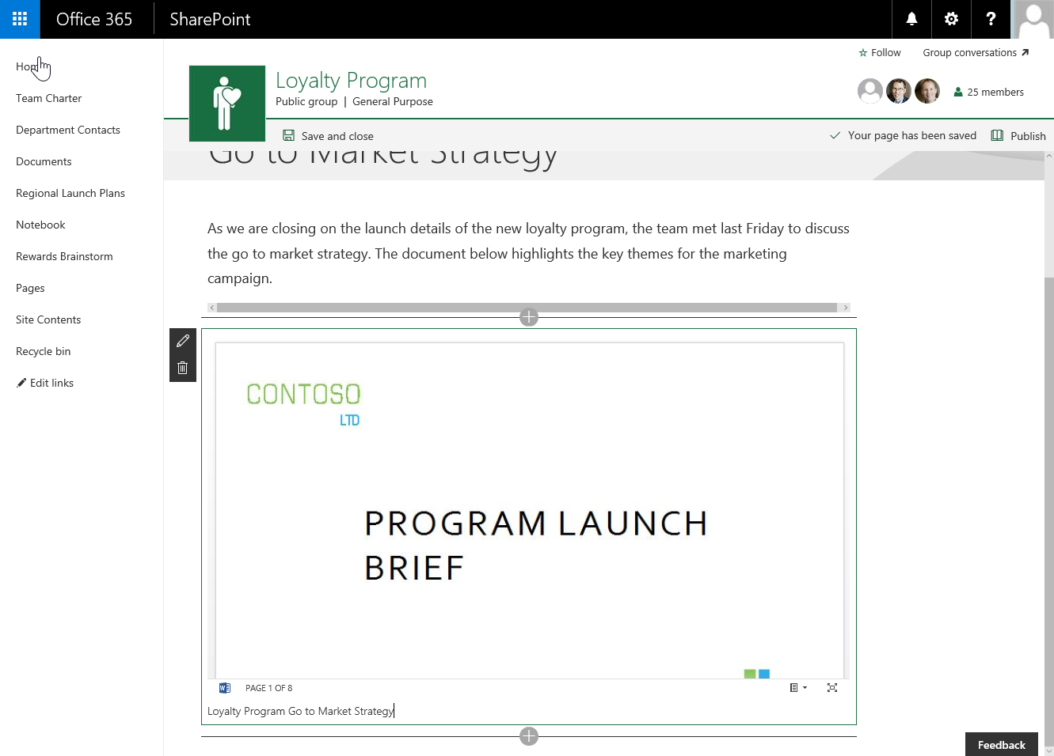
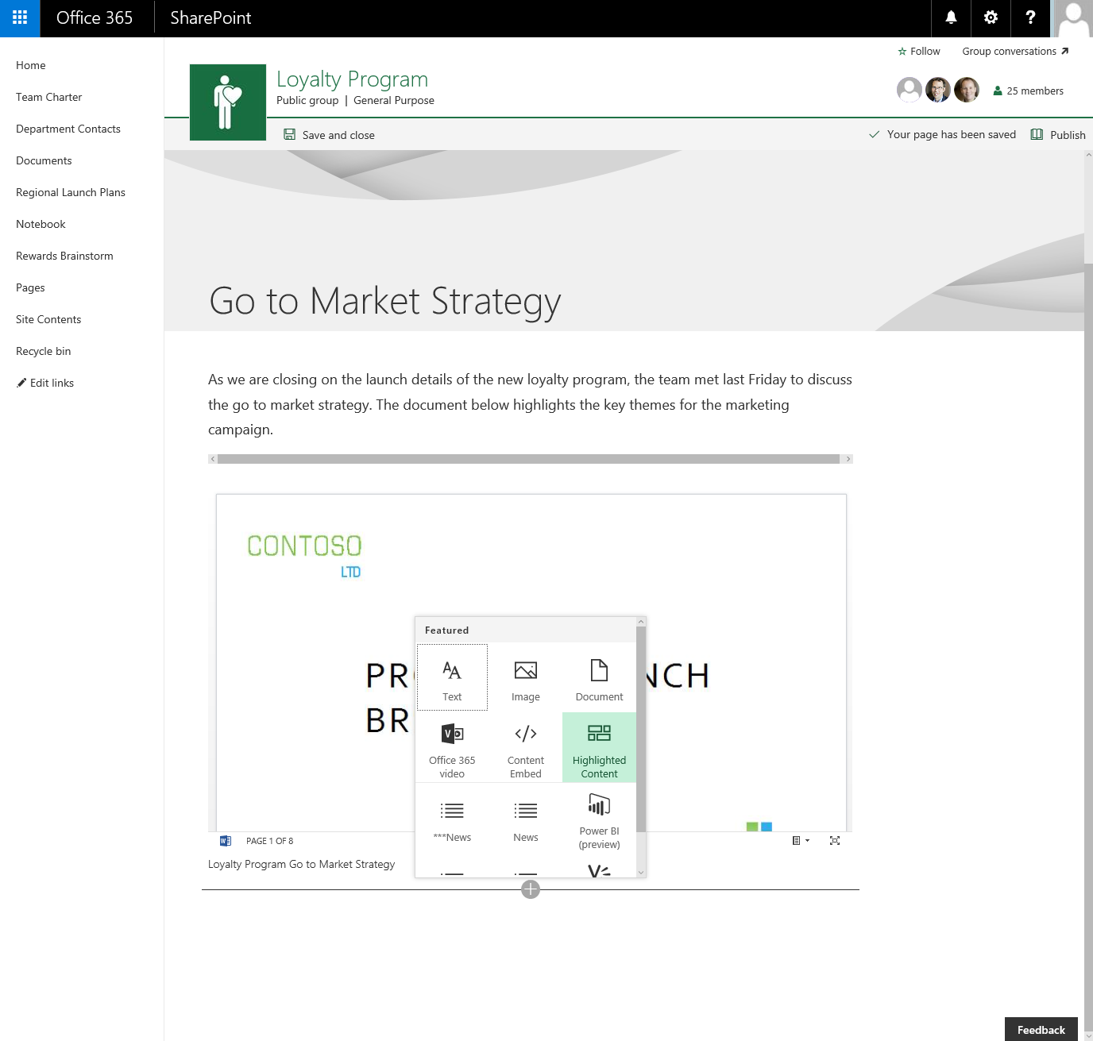
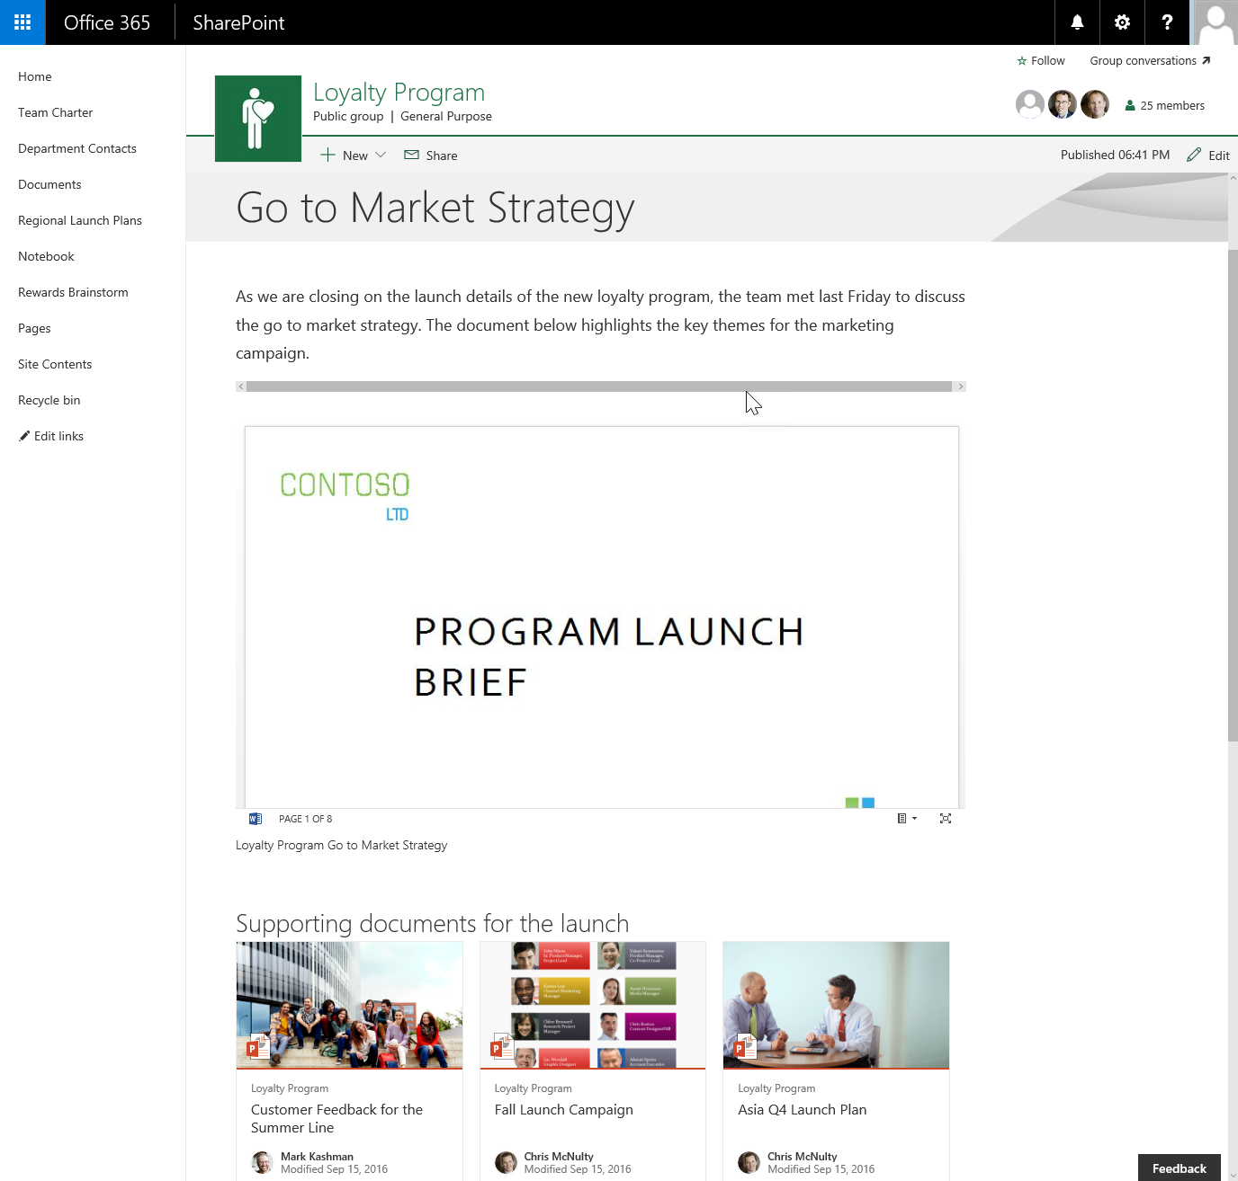
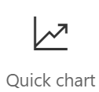
客户端侧 Web 部件
它们仍然是 Web 部件！
专为 JavaScript 驱动的现代 Web 构建
直接在 SharePoint 页面内运行
Notes:
Experienced SharePoint developers who are familiar with server-side web parts developed and deployed using SharePoint features and solutions will find client-side web parts to be familiar. They're just web parts!
The only difference from a server-side web part is client-side web parts are rendered in the browser, not on the server.
Client-side web parts are build for the modern, JavaScript-driven web just as the modern SharePoint experience.

Slide 18
探索 SharePoint 框架项目
Notes:
Create a client-side web with the SharePoint Framework
Demonstrate how to test a web part using the local workbench
Explain the differences and when to use the local vs. hosted workbench

Slide 19
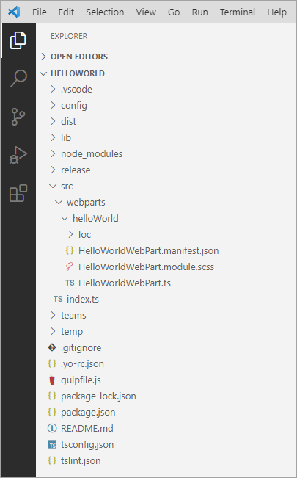
项目结构
.vscode：包含 Visual Studio 代码集成文件
config：包含所有配置文件
dist：包含所有捆绑进程的输出
lib：在生成时自动创建 – 包含预捆绑的生成文件
node_modules：在使用软件包管理器安装所有软件包依赖项时自动创建
release：包含生产捆绑流程的输出
src：这是项目的主文件夹，它包括 Web 部件、样式和测试文件
temp：在生成时自动创建 - 包含本地开发 Web 服务器文件
Notes:
The Yeoman generator for the SharePoint Framework creates the scaffolding (*folders & files*) for a new SharePoint Framework project. After building the project the first time, you'll see even more folders and files present. Just like a .NET Framework project, some of the generated files are temporary and should not be kept in source control.
Let's look at the folders in a newly created and built SharePoint Framework project:
**.vscode**: This folder contains contains Visual Studio Code specific files.
**config**: This folder contains configuration files used by the project's various build tasks. You'll edit these files as necessary depending on the types of components you're creating and for specific situations, such as the site to test extensions or adding references to external libraries.
**dist**: This folder contains the files generated when you bundle your project, regardless of which switch you use. The unminified JavaScript files and source maps contained in this folder are used when you run in debug mode.
**lib**: This folder, created automatically when you build the project, contains the temporary files generated from the compilation and transpilation of TypeScript to JavaScript and SCSS to CSS files.
**node_modules**: This folder is created automatically when installing package dependencies using the `npm install` command.
**release**: This folder contains a subfolder named **assets** that contains the files generated when you bundle your project using the `ship` or `production` switch. These files are deployed to the CDN. This folder also contains two additional subfolders that contain manifest files.
**src**: This folder contains all the source code for your project.
**temp**: This folder, created automatically when you test the project, contains files used by the local development web server.
> [!NOTE]
> The **dist**, **lib**, **node_modules**, and **temp** folders should not be committed to your source control solution because they are automatically generated by the build process and when installing or restoring dependencies.
>
> These folders are similar to the **bin**, **obj**, and **packages** folder generated in a .NET project.

Slide 20
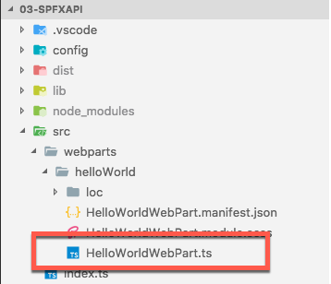
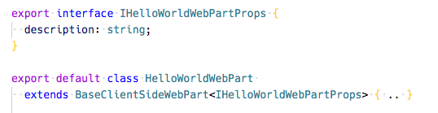
关键文件 – Web 部件类
定义 Web 部件的主入口点
扩展 BaseClientSideWebPart
所有的客户端 Web 部件必须扩展 BaseClientSideWebPart 类，以便被定义为一个有效的 Web 部件
定义 Web 部件的非标准公共属性的接口
在从编辑模式保存/发布 Web 部件时持续存在
Notes:
When you are creating web parts, the Yeoman generator for the SharePoint Framework will create a web part class file and add it to your project. This file is located within in the **./src/webparts/\[webpartName\]** folder. The name of the web part is added to the folder and the class' file name.
This file defines the main entry point for the web part and extend the `BaseClientSideWebPart` class. All client-side web parts must extend from this base class.
The web part file will contain both the web part class and in interface. The interface defines the nonstandard public properties on the web part and are persisted when the web part is saved or published from edit mode.

Slide 21
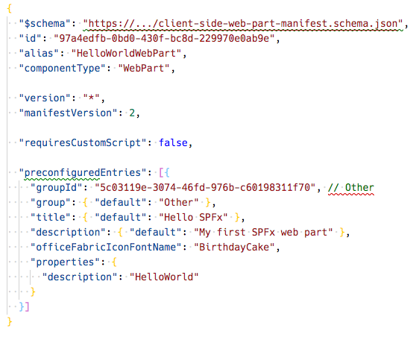
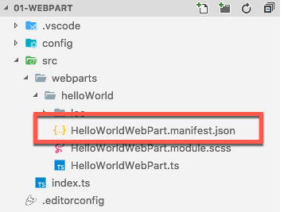
关键文件 – Web 部件清单
定义 Web 部件元数据
Notes:
The web part manifest file, **\*.manifest.json**, is located in the same folder as the web part class. It contains metadata for the web part that include things such as the web part's ID, alias, the type of component, and its version.
Web parts will also contain a section for `preconfiguredEntries` that are the default values for the public properties set on the web part when it is added to a new page.

Slide 22
CSS 单元
https://github.com/css-modules/css-modules
所有 CSS 类都在本地范围内
.helloWorld {} => .helloWorld_da83fer {}
SPFx 的构建工具链可处理复杂性
规则
*.module.scss - HelloWorldWebPart.module.scss
使用 CamelCasing；不使用 kebab-casing
将组件中的类作为 styles.helloWorldButton 引用
Notes:
CSS modules address a challenge you may have when working with client-side solutions. CSS classes can be used to not only set the styles of an element on the page, but can also override other CSS classes. If a CSS class name is present on the page more than once, the last one will override any settings on previously defined classes. For example, having different web parts that use the same CSS class name on the same page can impact the rendering of each web part.
CSS modules address this challenge by creating a globally unique name for each CSS class. A class named `.helloWorld` is translated to `.helloWorld_da83fer` for example. The hash at the end of the class name is unique to that web part project.
The SharePoint Framework build toolchain handles the complexities of generating these class names and referencing them in the your web part.
You define your classes in a SASS file. The class names can use **camelCasing** but not **kebab-casing** for the CSS module process to work. The SharePoint Framework build pipeline generates JavaScript and TypeScript type definitions for all the classes that map to the generated class names. In your web part, you will import the style object, `import styles from './HelloWorldWebPart.module.scss';`, and then reference the styles as a real TypeScript object:

Slide 23
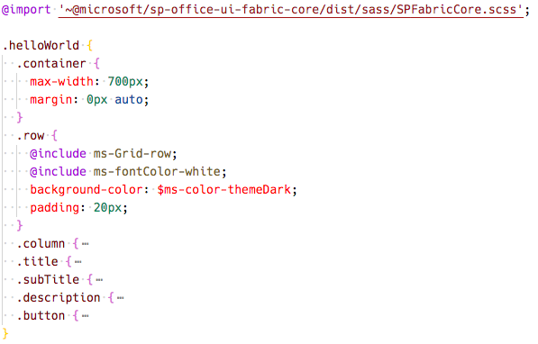
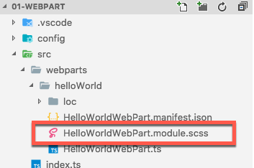
关键文件 – SCSS 文件
定义 Web 部件风格
Notes:
When the project is built & compiled, the SharePoint Framework build process will do two things with this file.
First, it will compile the SCSS => CSS for use in the browser.
Then, it will generate two additional files.
One is a JavaScript file that exports a single object with the name/value properties will have the CSS module local unique names as the values for the class names that are the properties. The other file is a TypeScript declaration file that contains an interface of this file. Using these two files you can import them into your web part and reference the friendly class names rather than the generated CSS local module names.

Slide 24
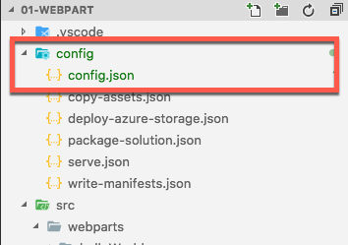
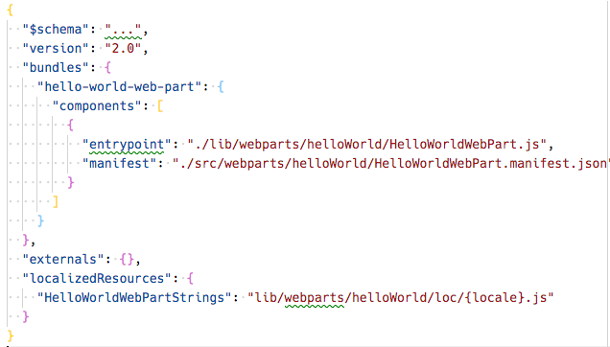
关键文件 – 配置文件
包含关于你的捆绑包、任何外部依赖关系、本地化资源的信息
指定 Web 部件中使用的 AMD 脚本库
Notes:
The **./config/config.json** file contains information about your JavaScript bundles, external dependencies, and localized resources.
The `bundles` node enables developers to control the name of the bundle file created by the bundling process and what components are included in the bundle. Each component is listed by the primary JavaScript file that contains the component and the component's manifest. These values are used by the SharePoint Framework's bundling process when it configures webpack on each build.
> [!NOTE]
> Webpack, another open-source tool, is included in each project's dependencies and is entirely managed by the build process. There is nothing for the developer to install or configure.
The `externals` node is where you can define external libraries that you don't want to be included in the resulting bundle created by Webpack. For example, if our component used the popular library jQuery, you shouldn't include it as part of the bundle. Instead, the external library should be loaded from an external CDN prior to loading the component bundle on the page. In this case, you'd add the jQuery CDN reference to the `externals` node. During the bundling process, when Webpack sees a reference to jQuery, it will ignore it and not include it in the bundle. In addition, the component's manifest will be modified to instruct the module loader in at runtime to load jQuery prior to loading the component's bundle.

Slide 25
客户端 Web 部件生成流程
npm install @Microsoft/generator-sharepoint -g
gulp serve
gulp bundle --ship
安装 SharePoint 生成器
测试
包装/部署
yo @microsoft/sharepoint
workbench
gulp package-solution --ship
Scaffold SharePoint Web 部件项目
本地或托管
包装/部署
代码。
manual upload of the app
构建 Web 部件代码
UAT / 前期制作
使用应用目录发布*
交付？
在经典和现代页面上可用
Notes:
Now that you understand the important folders and files in a project, let's look at the build toolchain and flow for a SharePoint Framework project. This scenario will focus on a project that contains a web part component. Other types of components, such as extensions and libraries, may involve a slightly different process or step.
In the figure above, the first column covers configuring your development environment for SharePoint Framework development by installing all the necessary dependencies. You then create the project using the Yeoman generator for the SharePoint Framework and develop your component.
Moving onto the second column, test your component in the local or hosted workbench by executing the command `gulp serve` from the command line from the root folder of the project. This task will build, bundle, start the local web server, launch the default browser, and navigate to the local workbench. Here you can add your web part to the local workbench's page to test it.
You can also test it in the hosted workbench by using the same browser and navigating to the hosted workbench. The hosted workbench will load the component from your local web server in the browser.
Follow standard development practices by iterating the component until you settle with the final version of your component that is ready to deploy.
The third column represents the deployment process. You'll first re-bundle the component using the `gulp bundle --ship` command that recreates the bundle for production. Next, create the deployable SharePoint package using the `gulp package-solution --ship` command. This command generates the **\*.sppkg** file.
Finally, Upload the SharePoint package to your tenant's or site collection's App Catalog site. At this point, the app can be installed in a site collection that will add the web part to the web part toolbox where it can be added to a page in edit mode.

Slide 26
演示
使用 SharePoint 框架开发 Web 部件
创建 SharePoint 框架客户端 Web 部件
Notes:
See the file M01_Manage roles and create teams.docx for instructions for this demonstration.​
​Demonstrations references in this deck utilize a Microsoft 365 E5 tenant and access to Microsoft Teams.
Set up instructions -Set up can take up to 60min
https://microsoft.sharepoint.com/:w:/t/FY20BaselineLocalEventsPlanning/ERs4HL_d3RNFiwERCPC3mGMBkKo0lIjdgJb_r78bpJYWyg?e=wIQtUi
​

Slide 27
利用 Microsoft Graph 和第三方 API
调用匿名第三方 REST API
调用 Azure AD – 安全的第三方 API
在 SharePoint 框架解决方案中调用Microsoft Graph
Notes:
This section introduces you to using external APIs in your SharePoint Framework projects. SharePoint Framework projects can incorporate data from anonymous APIs, those REST APIs secured with Azure AD, and Microsoft Graph.

Slide 28
消耗第三方 REST API

Slide 29
在 SPFx 中消耗 REST API – 概述
在 SPFx 项目中，常见的需求是显示 Web 部件外部的数据或与其进行交互。
SharePoint 列表和库中的数据
可通过 Microsoft Graph REST API 访问的数据
可通过外部第三方 API 访问的数据 – 匿名且安全
当你需要使用 Web 部件外部的数据源时，SharePoint 框架为所有情况提供了 API。
HttpClient：用于调用第三方 REST API
MSGraphClient：用于在与 SharePoint Online 租户相同的租户中调用 Microsoft Graph
AADHttpClient：用于由 Azure Active Directory 保护的第三方 REST API
大多数场景不需要额外的客户端/库。
Notes:
A common requirement for SharePoint Framework projects is that they display or interact with data external to the web part. This data can reside in SharePoint lists and libraries, or it may be accessible via Microsoft Graph. Maybe the data is external to SharePoint and Microsoft 365 and your project will need to request data from a third party REST API that may support anonymous requests or only support authorized requests because it is protected with Azure AD.
The SharePoint Framework includes multiple APIs you can use that address the different scenarios depending where the data resides and the specifics around the of HTTP API you'll need to call. There are three different APIs you'll use for specific scenarios.
The `HttpClient` API is the cornerstone for most HTTP requests in SharePoint Framework projects. You'll use the `HttpClient` API to primarily submit anonymous requests to third-party APIs. The `SPHttpClient` API extends the `HttpClient` to include necessary HTTP request headers used by the SharePoint REST API. For example, the `SPHttpClient` automatically includes an `odata-version` HTTP request header set to `4` to configure the SharePoint REST API from the default OData v3 protocol to OData v4.
The `MSGraphClient` API is used to call the Microsoft Graph REST API in the same tenant as the current SharePoint Online tenant. Unlike the other HTTP APIs in the SharePointFramework, the `MSGraphClient` API is used to obtain a configured instance of the Microsoft Graph JavaScript SDK client.
The `AADHttpClient` API extends the `HttpClient` API that is used to call Azure AD secured APIs. You'll use the Azure AD HTTP client API to obtain an instance of the `HttpClient` that includes an `authorization` HTTP request header with the value set to an access token used to authorize calls to an Azure AD secured HTTP endpoint.
None of these related HTTP request APIs require developers to install additional clients or libraries; the default SharePoint Framework project includes everything you'll need in your project to submit requests to REST APIs.

Slide 30
调用 Azure AD – 安全的第三方 REST API

Slide 31
使用 Azure AD 保护 REST API
Azure 中的资源可以通过 Azure AD 轻松实现安全保障
需要请求时，在请求时在 HTTP 标头中包含有效的 OAuth 访问令牌
类似于保护现有服务的方式
SharePoint REST API
Microsoft Graph API
Azure 管理 REST API
等等
Notes:
Azure AD can be used to secure REST APIs that are hosted in Microsoft Azure and API hosted in other cloud platforms. Microsoft Azure hosted resources are usually easier to secure as the Azure Management Portal provides a simplified configuration experience.
Azure AD secured REST APIs require all requests to be authorized. To authorize a request, you'll include an OAuth 2.0 access token in the `authorization` HTTP request header. This access token must be obtained from Azure AD using one of the supported OAuth flows.
All available Microsoft REST APIs that don't support anonymous requests are secured with Azure AD. This includes APIs including the SharePoint REST API, Microsoft Graph, Azure Management REST API and many more.

Slide 32
从 SPFx 调用 Azure AD 保护的资源
对资源的权限请求由租户管理员授予特殊的 SharePoint 应用
SharePoint Online 客户端可扩展性 Web 应用主体
在每个 SharePoint Online 租户中呈现
权限是租户独有的，而不属于 SPFx 解决方案。
授予权限后，所有解决方案都可以利用授予
权限授予在被撤销之前都是有效的
权限授予与请求的解决方案没有直接联系
解决方案的安装与权限授予的批准/拒绝没有关联
Notes:
Let's look at how requests to Azure AD secured resources are handled by the SharePoint Framework.
Permission requests to REST APIs, also known as *resources*, are granted to a Azure AD app provisioned in every SharePoint Online tenant: **SharePoint Online Client Extensibility Web Application Principal**.
When you grant a permission request for a specific resource, such as Microsoft Graph, to the **SharePoint Online Client Extensibility Web Application Principal** app, you are granting that entire SharePoint Online tenant the permission. Its important to understand that this permission grant isn't unique to the site or to the SharePoint Framework component; the permission grant applies to the *entire SharePoint Online tenant*.

Slide 33
向 SharePoint Online 授予权限
特殊的 SharePoint Online Azure AD 应用可以通过多种方式向资源授予权限。
在解决方案清单中定义 – 在部署时通知管理员以批准/拒绝
PowerShell
Office 365 CLI
参考：https://docs.microsoft.com/sharepoint/dev/spfx/use-aadhttpclient
Notes:
There are three ways you can request and grant permissions to a SharePoint Online tenant:
- **Defined with the SharePoint Framework package solution manifest**: In this option, you'll define the permission requests for the resources that your solution needs in order to run. When the solution is deployed to the App Catalog site, the administrator is notified that they will need to approve or reject the permission request.
- **PowerShell**: PowerShell can be used to submit a permission request, and approve or reject permission requests. You can also use PowerShell to create the permission grant, bypassing the request process.
- **Office 365 CLI**: You can also use the cross-platform Office 365 CLI to request, approve, reject, grant and revoke permission requests the same way you can with PowerShell.

Slide 34
工作原理：从 SPFx 调用 Azure AD 保护的 REST API
Notes:
After SharePoint Framework package has been added to the App Catalog, let's look the process for granting permissions and how the SharePoint Framework ultimately submits requests to the Azure AD secured REST API.
At the bottom of the figure above, the tenant administrator grants the permissions (also known as *scopes*), to the SharePoint Online tenant. This is done from the API Management page in the SharePoint Admin Center.
Once the permission request is granted, the SharePoint Framework component will ask SharePoint Online for an access token for the specified resource. The SharePoint Online, in conjunction with Azure AD, will validate the permission for the specified resource has been granted to that SharePoint Online tenant and return an access token. The SharePoint Framework will then submit a request to the REST API and include the access token in the `authorization` HTTP request header.
The Azure AD secured resource will verify the `authorization` HTTP request header before passing to the REST API. From this point, the HTTP request continues like normal, processing the request and sending the response back to the SharePoint Framework component.

Slide 35
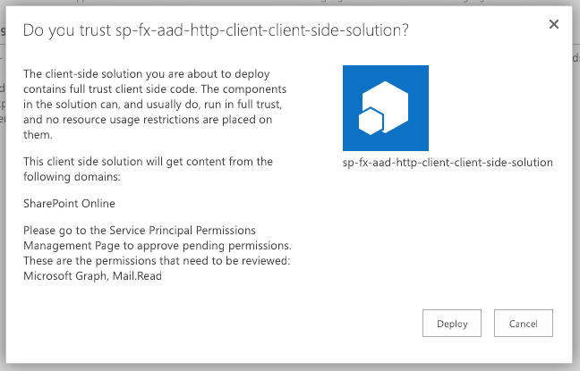
将 SharePoint 包添加到 SharePoint 应用目录
将 SharePoint 包上载到应用目录
对话中的额外注释会通知需要的其他步骤
虽然应用可以安装在 SharePoint 站点中，但它没有获得访问受 Azure AD 保护的资源所需的权限
Notes:
When an administrator deploys the SharePoint Framework component to the tenant App Catalog, they're presented with an additional message in the trust dialog prompt:
This message instructs the administrator that this solution contains permission requests that should be reviewed and approved or rejected. Recall that permissions are not tied to the SharePoint Framework package. Approving or rejecting the permissions is a separate step that must be performed in order for the SharePoint Framework component to work.

Slide 36
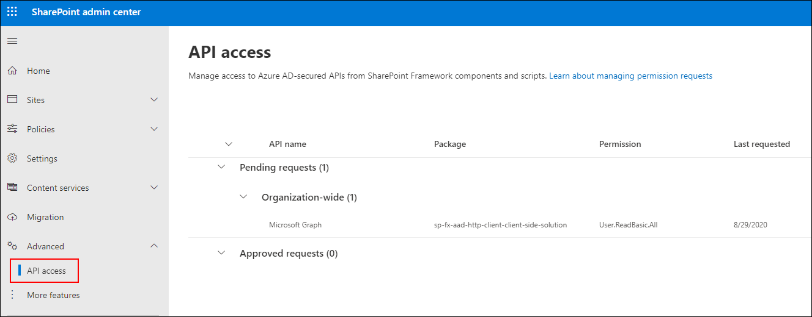
使用 SharePoint Online API 管理页面批准/拒绝
Notes:
To approve or reject permission requests, navigate to the **API access** page in the **SharePoint Admin Center**. Here you'll find a list of permission requests pending approval or rejection.

Slide 37
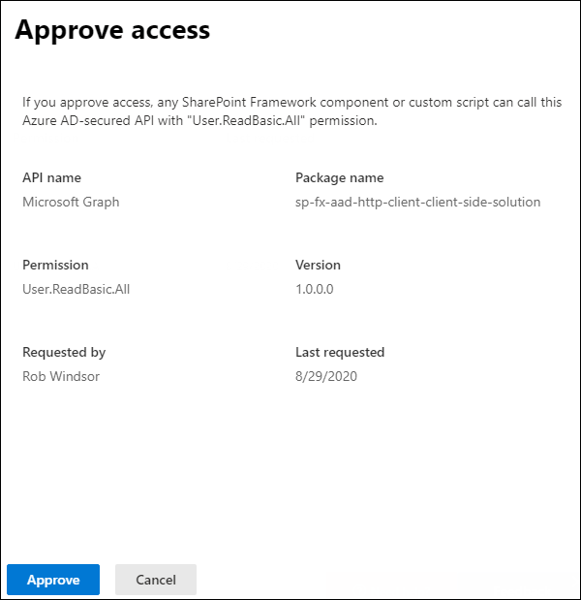
使用 SharePoint Online API 管理页面批准/拒绝
Notes:
Select the permission request to view its details and use the buttons at the bottom of the panel to approve or reject the request:

Slide 38
在 SharePoint 框架解决方案中调用Microsoft Graph

Slide 39
演示
利用 Microsoft Graph 和第三方 API
从 SharePoint Framework 组件调用 Microsoft Graph
Notes:
See the file M01_Manage roles and create teams.docx for instructions for this demonstration.​
​Demonstrations references in this deck utilize a Microsoft 365 E5 tenant and access to Microsoft Teams.
Set up instructions -Set up can take up to 60min
https://microsoft.sharepoint.com/:w:/t/FY20BaselineLocalEventsPlanning/ERs4HL_d3RNFiwERCPC3mGMBkKo0lIjdgJb_r78bpJYWyg?e=wIQtUi
​

Slide 40
使用 SPFx 构建 Microsoft Teams 自定义项
将 SPFx Web 部件部署为 Microsoft Teams 选项卡
为 SharePoint Online 和 Microsoft Teams 创建 web 部件
Microsoft Teams 选项卡中的客户端 Web 部件设置
Notes:
This section will introduce you to leveraging your SharePoint Framework customizations in Microsoft Teams.

Slide 41
将 SPFx Web 部件部署为 Microsoft Teams 选项卡

Slide 42
使用 SharePoint 框架扩展 Microsoft Teams 的好处
开发模式类似于 SharePoint 框架的 Web 部件
任何 Web 部件都可以在 Microsoft Teams 中作为选项卡公开
在将自定义选项卡作为 Web 部件和租户中的选项卡公开时，有不同的范围选项
在特定团队背后的底层 SharePoint 网站的上下文中执行的选项卡
在你的 Web 部件中利用任何 SharePoint 特定的 API 或功能!
直接从 SPFx API 访问 SharePoint REST API、Microsoft Graph、Azure AD 安全端点等
Notes:
In 2019, Microsoft introduced the capability to use a SharePoint Framework client-side web part as a tab in Microsoft Teams. As we've previously covered, a Microsoft Teams tab is just a web page loaded in an Iframe.
The development process of a Microsoft Teams tab that's implemented using a SharePoint Framework client-side web part is nearly identical to creating a web part for a SharePoint site. Any web part can be exposed as a tab in Microsoft teams.
To enable a client-side web part to be used as a tab in Microsoft Teams, you'll need to update a single property in the component's manifest.
When you use a client-side web part as the host for a Microsoft Teams tab, the URL for the tab is a page in SharePoint Online that contains a single canvas no the page. The URL parameters tell the SharePoint page which web part to load into the canvas. This URL is used to in the Iframe that implements the tab.
The tab, or client-side web part, executes in the context of the underlying SharePoint site behind the team that the tab is added to. The implications of hosting the tab in SharePoint means developers can leverage the SharePoint Framework API in their custom tabs. For example, because the client-side web part is running in SharePoint Online, you can access the SharePoint REST API, Microsoft Graph, and Azure AD secured endpoints all from the SharePoint Framework API without needing to force the user to authenticate again.

Slide 43
如何将 SharePoint 框架 Web 部件显示为 Microsoft Teams 选项卡？
指定 Web 部件可以是选项卡
创建 Microsoft Teams 选项卡图像和描述
创建 Microsoft Teams 应用清单
Notes:
The process of configuring a SharePoint Framework client-side web part to be used as a Microsoft Teams tab is straightforward. Assuming you've built and tested your SharePoint Framework client-side web part, there are three actions to take:
1. **Specify the web part can be a tab**: Locate the web part's manifest file. Within the manifest file, locate the property array `supportedHosts`. The `supportedHosts` property lists all the different places the web part can be run. By default, it contains a single entry `SharePointWebPart`. To configure the web part to be used as a Microsoft Teams tab, add `TeamsTab` to the array.
1. **Create Microsoft Teams tab images**: When you create a new SharePoint Framework project, it creates a folder **./teams** in the SharePoint project with two images. The images, named **{SP_COMPONENT_GUID}_color.png** and **{SP_COMPONENT_GUID}_outline.png**, are used by Microsoft Teams when displaying your tab. You can replace these default images with your own custom images, but make sure you don't change the size dimensions or names of the files.
1. **Create Microsoft Teams app manifest**: All Microsoft Teams apps need an app manifest that describe the app. You can create the manifest yourself, or you can let SharePoint create it for you.

Slide 44
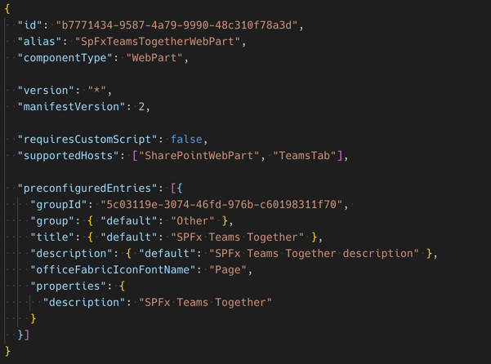
指定 SharePoint 框架 Web 部件可以是 Microsoft Teams 选项卡
Web 部件清单属性： supportedHosts
SharePoint 中的 Web 部件： SharePointWebPart
Microsoft Teams 中的选项卡： TeamsTab

Slide 45
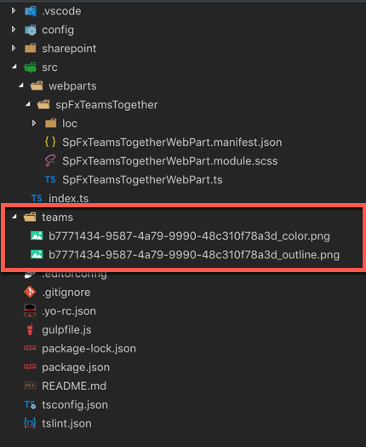

创建 Microsoft Teams 选项卡图像
默认 Microsoft Teams 选项卡图标

Slide 46
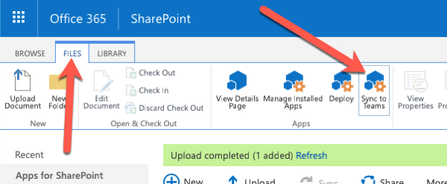
创建 Microsoft Teams 应用清单
将应用告知 Microsoft Teams：
图像的名称和位置
应用的名称和描述
应用的”关于“和元数据
底层应用的位置
作为 Teams 选项卡的 SharePoint 框架 Web 部件 – 在 SharePoint 组件的清单中已经有了大部分的信息
SharePoint 可以自动创建和部署 Microsoft Teams 清单
在 SharePoint 应用目录中执行的流程
动态创建 Microsoft Teams 应用清单
压缩清单 + 图像
部署到 Microsoft Teams 商店
Notes:
The Microsoft Teams app manifest tells Microsoft Teams about your custom app. It contains the name and location of the images, name and description of the tabs, the location of the application, and other metadata about the app.
When you use a SharePoint Framework client-side web part as a tab, you have the option to create the app manifest yourself, or to let SharePoint create it for you.
After uploading and deploying the SharePoint package to the SharePoint App Catalog, you'll notice a **Sync to Teams** button in the ribbon when you select the package.
When you select the **Sync to Teams** button, SharePoint will look for a custom Teams app package named **TeamsSPFxApp.zip** in the **./teams** folder of your project. If SharePoint doesn't find this file, then it will dynamically create the Teams app manifest and package. SharePoint will then deploy the Teams app package (custom or generated) to the tenant's Teams app store. For more information, see the documentation: [Deployment options for SharePoint Framework solutions for Microsoft Teams](https://docs.microsoft.com/en-us/sharepoint/dev/spfx/deployment-spfx-teams-solutions).

Slide 47
演示
使用 SharePoint 框架构建 Microsoft Teams 自定义项
将 SPFx Web 部件部署为 Microsoft Teams 选项卡
Notes:
See the file M01_Manage roles and create teams.docx for instructions for this demonstration.​
​Demonstrations references in this deck utilize a Microsoft 365 E5 tenant and access to Microsoft Teams.
Set up instructions -Set up can take up to 60min
https://microsoft.sharepoint.com/:w:/t/FY20BaselineLocalEventsPlanning/ERs4HL_d3RNFiwERCPC3mGMBkKo0lIjdgJb_r78bpJYWyg?e=wIQtUi
​

Slide 48
为 SharePoint Online 和 Microsoft Teams 创建 web 部件
Notes:
This topic covers how to conditionally display information depending on whether the SharePoint Framework client-side web part is running in a SharePoint or Microsoft Teams environment.

Slide 49
SharePoint 框架和 Microsoft Teams 上下文
SharePoint 框架 Web 部件可以访问当前页面上下文
提供对当前页面、网站和网站集的访问权限
SharePoint 框架 1.8.0 版引入了 Microsoft Teams 上下文对象
Microsoft Teams JavaScript SDK 中提供的相同 Microsoft Teams 上下文对象
NPM 软件包：@microsoft/teams-js
利用 Microsoft Teams 上下文是否存在来确定 Web 部件是否在 SharePoint 或 Microsoft Teams 中运行
Notes:
All SharePoint components, including client-side web parts, have access to the current context. The context, available from the `this.context` object, gives your components access to details about the page the component is running on.
Your component can use the page's context, accessible from the `this.context.pageContext` object, to get information about the current site site collection, site, page, and user.
Microsoft introduced a new context in the SharePoint Framework v1.8 release when they added support for deploying client-side web parts as Microsoft Teams tabs. The `this.context.sdks.microsoftTeams` object is a reference of the `microsoftTeams` object available in the **\@microsoft\teams-js** package.
A client-side web part can detect if it is running in SharePoint or Microsoft Teams by checking if the `microsoftTeams` object is set to a value or is undefined. If it is `undefined`, then the component is not running in Microsoft Teams.

Slide 50
Microsoft Teams 选项卡中的客户端 Web 部件设置
Notes:
In this unit, you'll learn how to configure your SharePoint Framework client-side web part's settings when it's used as a tab in Microsoft Teams.

Slide 51
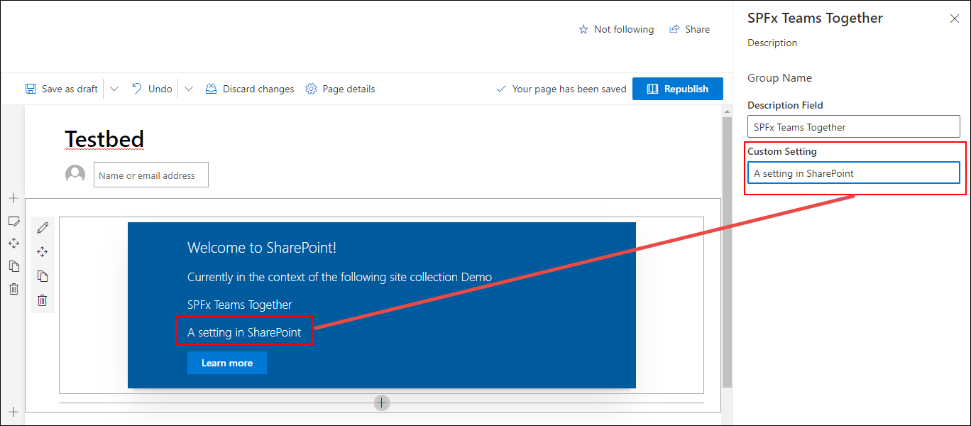
自定义 Microsoft Teams 选项卡配置选项
SharePoint 框架 Web 部件具有公共属性
公共属性可以通过属性窗格进行编辑
SharePoint 页面必须处于编辑模式才能编辑属性
用户必须具有页面的编辑权限才能访问属性窗格
Notes:
SharePoint client-side web parts can have public properties. Developers can expose these properties to form controls within the SharePoint property pane for users to edit.
The property pane is only available when the page is in edit mode and only after a user has selected the edit control on the web part. The current user must also have access to edit the page in order to modify the settings on the web part.

Slide 52
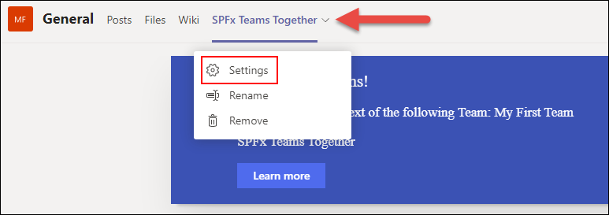
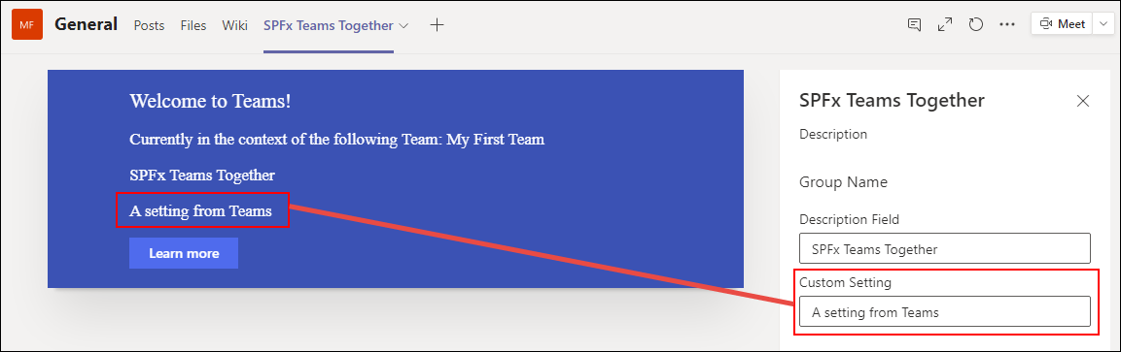
Microsoft Teams 中公开的属性窗格
当 SPFx Web部件作为选项卡安装在 Microsoft Teams 团队中时，显示 Web 部件属性面板
可通过选项卡上下文菜单访问设置选项
Notes:
The properties, called *settings*, on a tab in Microsoft Teams can also be modified by a user. To modify a tab's settings, select the tab's context menu and select the **Settings** option.
When the **Settings** menu option is selected, Microsoft Teams tabs launch a dialog that the tab that the developer implements.
However, when a web part is used as a Microsoft Teams tab, the tab is loading a SharePoint page that's hosting the client-side web part. When the **Settings** menu item is selected in teams, instead of opening a dialog, Microsoft Teams notifies SharePoint the page is now in edit mode. SharePoint's native property pane experience is then used to display edit the web part's public properties:

